Slide 1

Political Support Needed to Improve Transportation
SFMTA | Municipal Transportation Agency Image: Market and Geary Streets, circa 1920s, Muni Centennial logo
06 | 25 | 2013
SAN FRANCISCO, CALIFORNIA

Slide 2
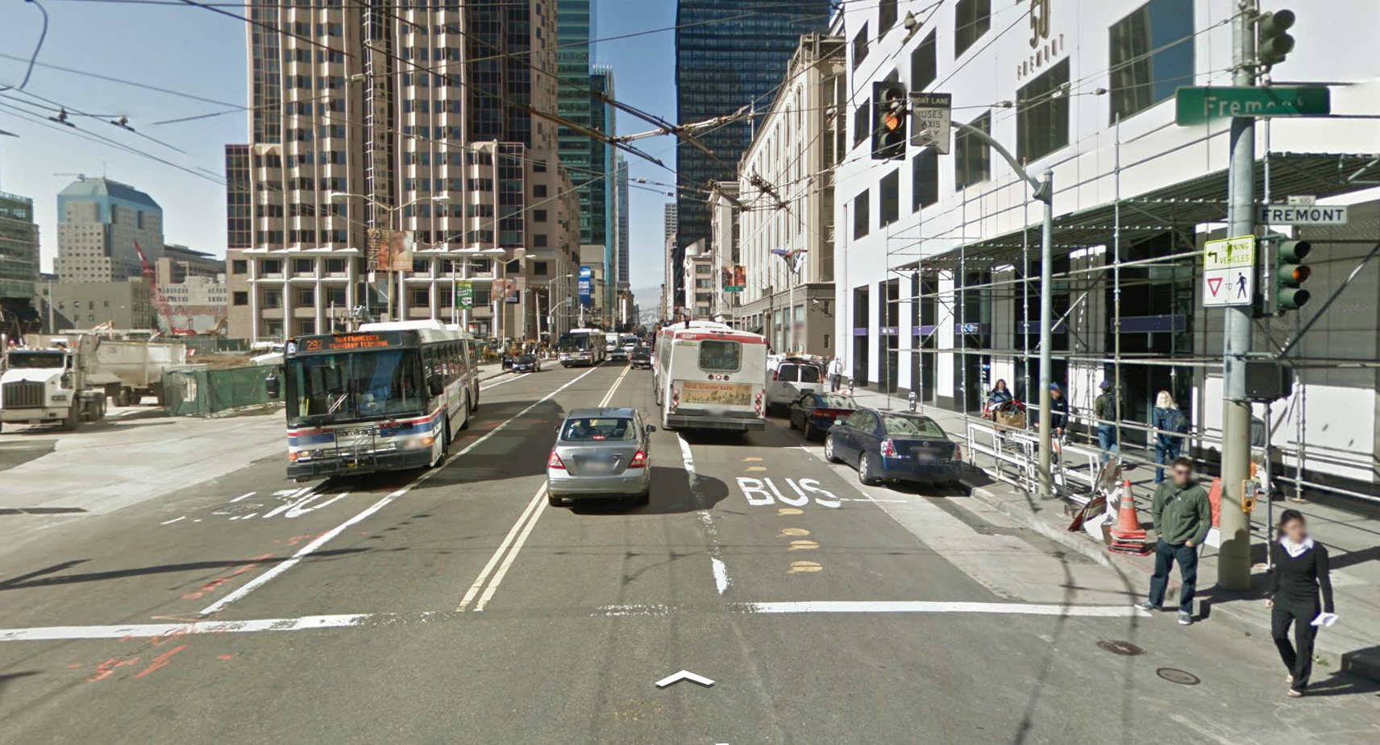
Key Issues
SFMTA manages multiple services within a constrained Right of Way
  Trade-offs among modes and objectives are required
SFMTA has Charter authority to make decisions but limited political ability to implement those decisions
  Oftentimes, changes benefitting the collective good have impacts at the individual level
  General conceptual support, but limited project-specific support
  Proposals are data-driven, but decision-making is often individually-based

Slide 3
1. Transit Priority
Transit-only lanes
Transit signal priority
Collective Benefit | Individual Impact
Reduce transit travel times between 5% to 50% Reinvest resources for increased service Faster, more reliable service attracts ridership | Constrained automobile traffic Reduced parking availability
Notes:
What it is:
Transit-only lanes can be created by converting an existing mixed-flow lane or by removing a parking lane, and can be dedicated full-time or for certain hours of the day. Transit signal priority provides longer green/delayed yellow lights triggered by transit vehicles, to allow transit vehicles to pass through intersections more quickly.
Importance & Benefit:
Transit-only lanes can reduce travel times between 10-50% depending on congestion. Transit signal priority saves XXXX.
Expected Result:
Travel time reductions of at least 20%.
Support Needed:
Support up to 100 miles of dedicated transit lanes converted from travel lanes or parking lanes (TEP, +8 other streets). Support transit signal priority at XXXX. Automobile traffic will likely be delayed/more congested as a result of giving priority to transit vehicles.

Slide 4
2. Transit Stop Consolidation
Remove closely-spaced transit stops, where appropriate
Collective Benefit | Individual Impact
Reduce transit travel times between 10% to 25% Reinvest resources for increased service Faster, more reliable service attracts ridership Stops can be converted to neighborhood public space needs | Increased walking time to access transit for some riders
Notes:
What it is:
Consolidate transit stops as appropriate to optimize access to the system while minimizing travel time delay. Stop spacing takes into consideration street grades and surrounding land uses, transfers to other routes, ridership and walking distances.
Importance & Benefit:
Removing closely spaced transit stops can decrease transit travel times between 10-25% (20-30 seconds per stop consolidated).
Expected Result:
Shorter travel times attract ridership. Time savings can be reinvested to increase service frequency and reduce overcrowding.
Support Needed:
Support for reducing number of transit stops on local and limited lines (TEP). Will increase walking time to access transit for some riders.

Slide 5
3. Transit Service Realignment
Adds service in some areas, reduces service in some areas and changes specific service routes
Collective Benefit | Individual Impact
Realigning service allows Muni to provide the right level of service to its riders Allocates resources where they are most effectively used | Some transit customers will be impacted by reduced frequencies or longer walks to access transit
Notes:
What it is:
Muni’s transit service requires realignment to provide the most appropriate service levels to changing ridership and travel patterns. Service realignment includes adding service in some areas, reducing service in some areas, and changing specific service routes.
Importance & Benefit:
Realigning service allows Muni to provide the right level of service to its riders, and to put its resources where they are most effectively used.
Expected Result:
Increased service in high-demand areas. Reduced service in low-demand areas.
Support Needed:
Service level changes are historically difficult to implement on a line-by-line basis. Support service level changes identified in the TEP.

Slide 6
4. On-street Car Sharing Spaces
On-street parking spaces dedicated to car-sharing programs
Collective Benefit | Individual Impact
Reduced car ownership, increased walking, bicycling and transit usage Reduced congestion | Decrease in general on-street parking availability in specific neighborhoods
Notes:
What it is:
Car sharing is a for-hire car program that allows people to use cars when they need them. They are parked in structures, buildings or on the street.
Importance & Benefit:
Car sharing has been proven to create the conditions for reduced car ownership, increased walking, bicycling and transit usage while reducing household costs and congestion.
Expected Result:
More on-street spaces throughout the city will allow car sharing to become ubiquitous freeing up parking and congestion.
Support Needed:
Support up to 1,000 on-street parking spaces dedicated for car sharing.

Slide 7
5. Expand Where & When Parking is Managed
Expand SFMTA parking management to commercial and mixed use areas
Extend meter hours into the evening in areas where parking demand is high
Collective Benefit | Individual Impact
Supports the city’s overall goals for land use and quality of life Reduced time to locate parking Reduced congestion for Muni Reduced potential for auto-pedestrian & auto-bicyclist collisions Encourages economic vitality | Increased parking costs in certain neighborhoods and/or at certain times of day Increased parking availability Decreased ability to store vehicles for long periods
Notes:
What it is:
Difficulty in finding parking is bad for drivers, Muni, and safety (because it increases double parking and circling), as well as erodes economic vitality in commercial areas. Metering on Sundays was an important first step. The SFMTA should expand its parking management to commercial and mixed use areas (e.g., NE Mission, Potrero Hill flats, Dogpatch, Design District) and extend meter hours into the evening in areas where parking demand is high (e.g., Mission, Castro).
Importance & Benefit:
Good parking management is good for automobile drivers, non-drivers, and business vitality. It is consistent with the city’s overall policies for transportation management, and supports overall goals for land use and quality of life.
Expected Result:
Reduced time to locate parking for people that drive to destinations, reduced congestion for Muni, reduced potential for auto collisions with people crossing streets/riding bicycles.
Support Needed:
Support expansion of parking management to all areas of the city, including additional meters and/or extended meter hours where appropriate.

Slide 8
6. Accessible Parking Policy
Forward a bill to give cities more flexibility in how they manage accessible (disabled placard) parking
Use meters to manage demand for a finite supply of on-street spaces, requiring payment by all
Collective Benefit | Individual Impact
Dramatically improves access for those with disabilities by making it possible to find a parking space close to their destination More access to key destinations by people with disabilities Reduced circling time and pollution | Disabled placard holders required to pay for meters Improved access to parking
Notes:
What it is:
The SFMTA is working with other cities to forward a bill in the 2014 state legislative agenda that would give cities more flexibility in how they manage accessible, or disabled placard, parking. Locally, this would allow the SFMTA to pursue the only solution that has worked in other cities, to use meters to manage demand for a finite supply of on-street spaces, requiring payment by all, including those with placards, at meters.
Importance & Benefit:
Improve access dramatically for those with disabilities by making it easier to find a parking space close to their destination. Issue of statewide importance – all major California cities have issues with disabled placards, and San Francisco’s leadership will help them to address those issues.
Expected Result:
More access to key destinations by people with disabilities
Support Needed:
Support accessible parking policy recommendations.

Slide 9
7. Dedicated & Protected Bicycle Lanes
A continuous network is the key attractor to people using bicycles
Dedicated lanes require space either converted from travel lanes or on-street parking or narrowing lanes
Collective Benefit | Individual Impact
Dramatically increase bicycle usage Increased public health and fitness Increased economic activity Increased transport affordability | Reduced on-street parking availability Constrained automobile traffic
Notes:
What it is:
A continuous network is the key attractor to people using bicycles. Dedicated lanes require space either converted from travel lanes or on-street parking or narrowing lanes.
Importance & Benefit:
Dedicated and protected bicycle lanes are the most proven way to dramatically increase bicycle usage. Lanes can be added with paint, and buffers can be upgraded over time
Expected Result:
Multiple outcomes: increased public health and fitness, economic activity, transport affordability, mode shift.
Support Needed:
Support upgrading up to 100 miles of the bicycle network and gap closures.

Slide 10
8. Implement Bicycle Sharing
A short-period for-hire bicycle program that allows people to ride bicycles from one point to another
Bicycles are in a pod either in parking structures or in the street right of way
Collective Benefit | Individual Impact
A highly effective way to grow bicycle usage quickly Helps shift some short transit trips and brings customers to and from transit | Reduced parking availability OR Use of public space for bike sharing pods
Notes:
What it is:
Bicycle Sharing is a short period for hire bicycle program that allows people to ride bicycles from one point to another. Bicycles are in a pod either in parking structures or in the street right of way.
Importance & Benefit:
Bicycle sharing has been proven globally as a highly effective way to grow bicycle usage quickly.
Expected Result:
Bicycle Sharing requires pods that need a parking space or similar dedicated space.
Support Needed:
Support up to 500 parking spaces or other public space throughout the city for bicycle sharing pods.

Slide 11
9. Establish 20 MPH Zones in Neighborhoods
20 MPH zones improve neighborhood perception of traffic safety
Current State practice specifies 25 mph speed limits
Collective Benefit | Individual Impact
20 mph is the universal speed standard where more than 90% of the population would survive a traffic collision Reducing traffic speeds is the most effective way to reduce serious and fatal collisions | Slower automobile traffic
Notes:
What it is:
Reducing traffic speeds is the most effective way to reduce serious and fatal collisions. Neighborhood zones at 20 mph greatly improve neighborhood perception of traffic safety.
Importance & Benefit:
20MPH is the universal design standard where more than 90% of the population survives a traffic collision.
Expected Result:
Reductions in serious and fatal collisions in neighborhoods.
Support Needed:
Support implementation of 20mph zones in neighborhoods.

Slide 12
10. California Environmental Quality Act (CEQA) Reform
Measure development’s impacts to the transit system as an environmental impact rather than traffic flow
Environmental mitigations would take the form of improvements to the overall transportation system
Collective Benefit | Individual Impact
Aligns environmental review practices and mitigations with the City’s Transit First policy Increases funding for comprehensive transportation system improvements. | Extends mitigation fees to land use types not currently paying fees Streamlines CEQA analysis
Notes:
What it is:
Efforts are underway to change the transportation impact analysis methodology under CEQA. The change would measure development’s impacts to the transit system as an environmental impact, rather than development’s impacts to automobile traffic flow. This change would mean that environmental mitigations would take the form of improvements to the overall transportation system with a focus on transit, rather than (usually infeasible) improvements to auto flow, such as roadway widening.
Importance & Benefit:
This program ensures that development’s cumulative impacts to the transportation system are offset by improvements to the transportation system as a whole, in line with City policies and priorities. Coupled with a mitigation fee, the program funds system improvements with a focus on transit.
Expected Result:
Aligns environmental review practices and development mitigations with the City’s Transit First policy. Increases funding for comprehensive transportation system improvements.
Support Needed:
Support CEQA reform, including the potential for “streamlining”, or reduced need for future transportation impact analyses. Support application of mitigation fees to all land use types.

Slide 13
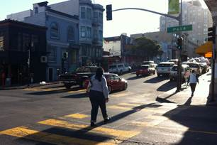
Needed Support
Balance the collective benefit against the individual impact
  Endorse key improvements outlined here
  Speak in support at public hearings
  Support SFMTA outreach with constituents and stakeholders
Communicate benefits, while acknowledging trade-offs
  Promote through traditional, social media and other networks
  Advocate with elected officials
Assume positive intent

