Slide 1
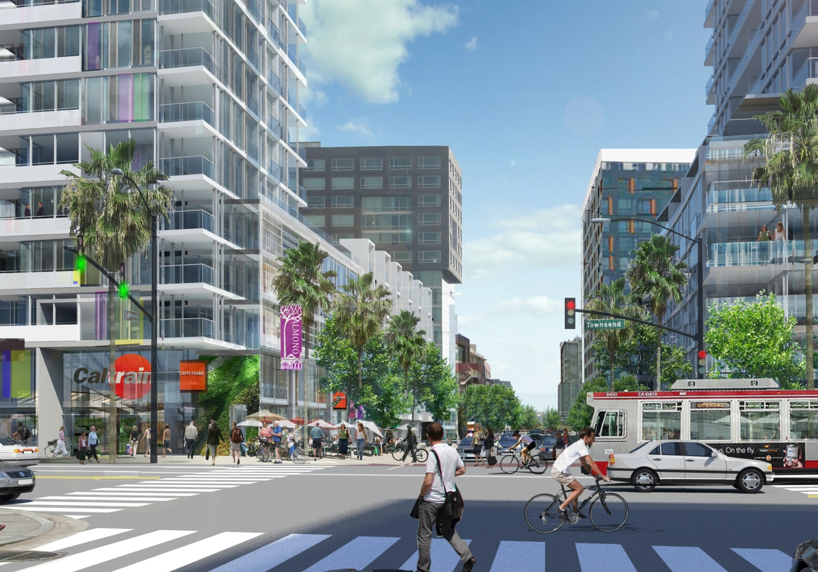
PRIORITY PLANNING PROJECT
Railyard Alternatives & I-280 Feasibility Study
Hi, I’m Susan

Slide 2
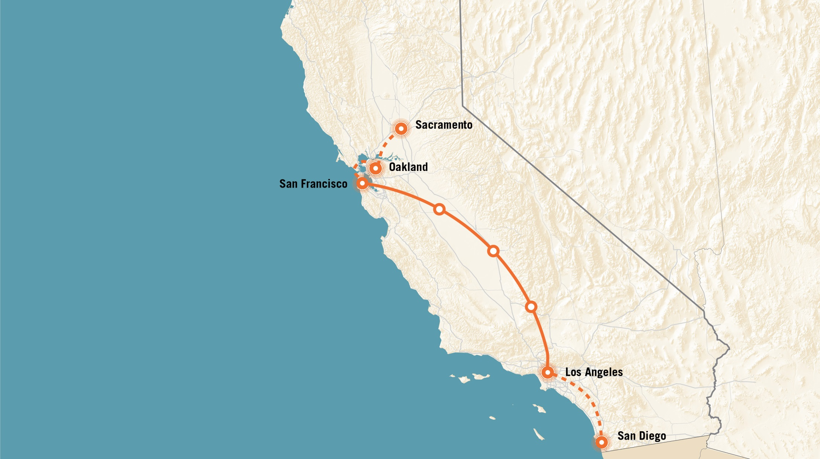
Connecting California
CALIFORNIA
 | 2015 | 2065 | Growth
Population | 39 M | 52 M | +33%
Employees | 16 M | 28 M | +77%

Slide 3
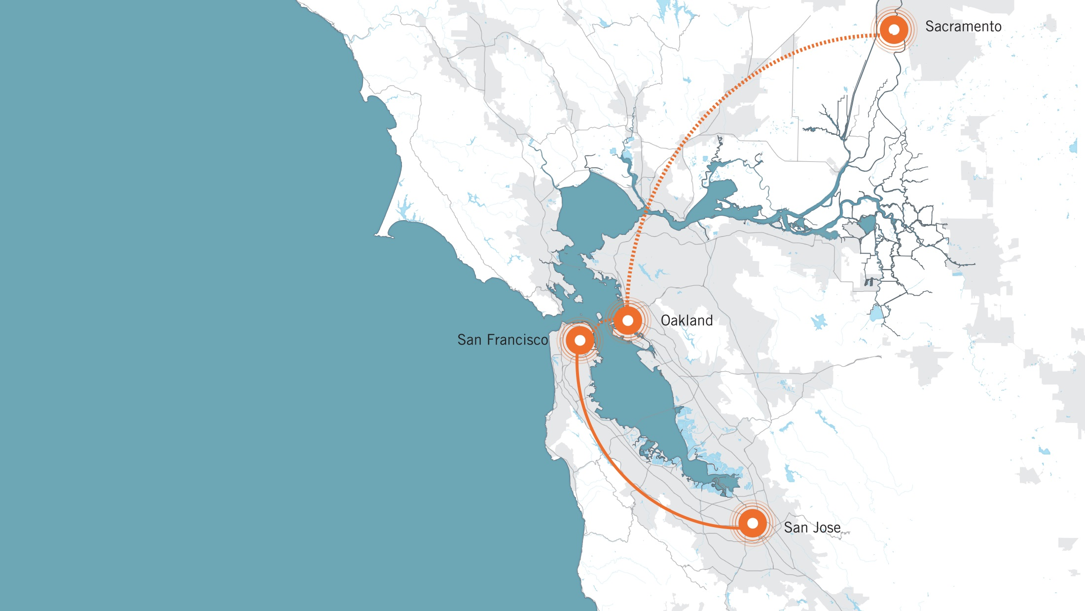
Connecting the Bay
BAY AREA
 | 2015 | 2065 | Growth
Population | 7.6 M | 10.7 M | +41%
Employees | 4.0 M | 5.8 M | +44%

Slide 4
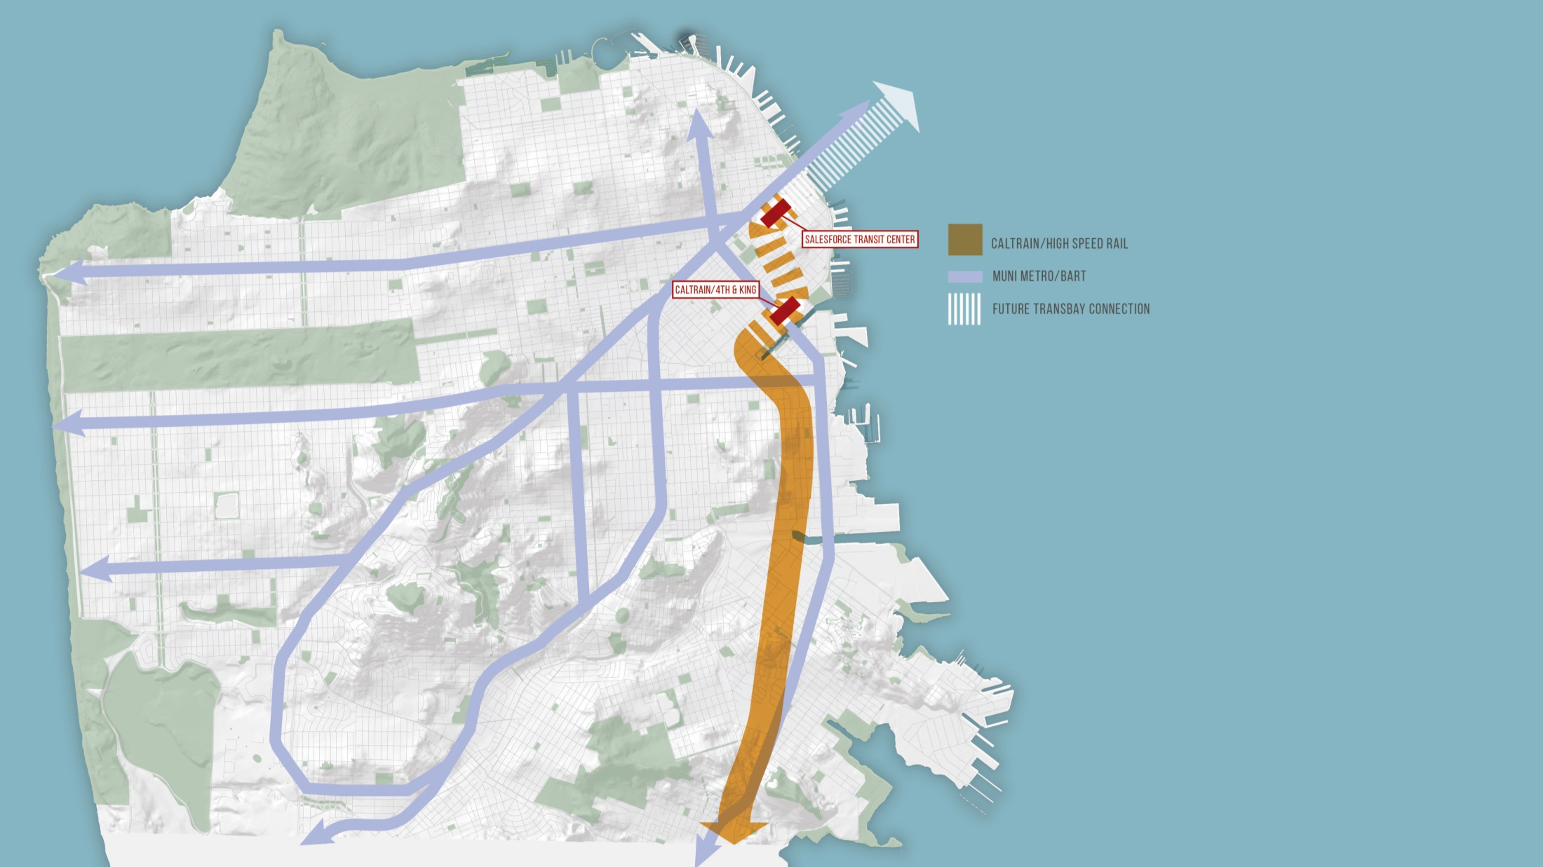
Connecting San Francisco
SAN FRANCISCO
 | 2015 | 2065 | Growth
Population | 860,000 | 1,430,000 | +66%
Employees | 700,000 | 995,000 | +44%

Slide 5
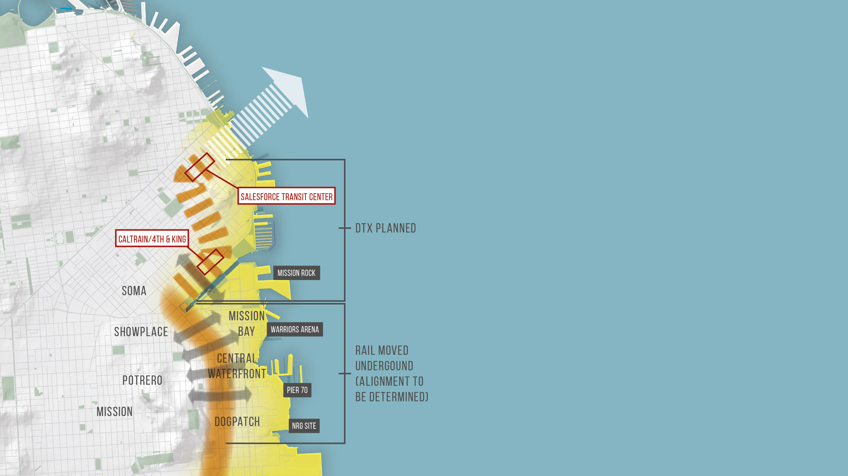
Reconnecting Neighborhoods
Financial District, Mission Bay, SoMa, Southern Bayfront
 | 2015 | 2065 | Growth
Population | 87,000 | 257,000 | +194%
Employees | 304,000 | 554,000 | +82%

Slide 6
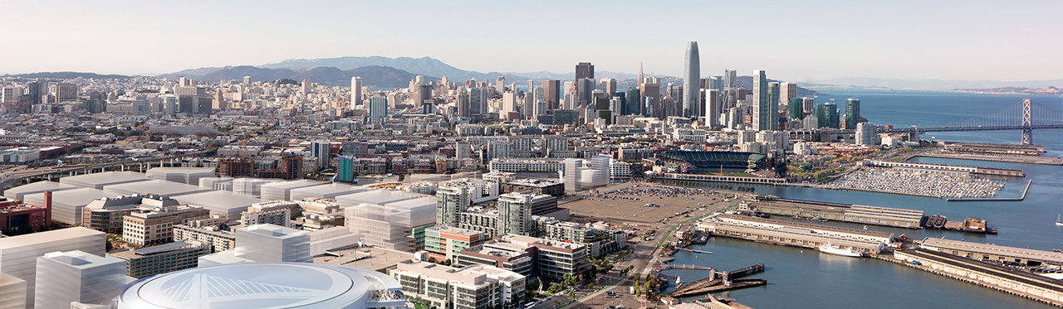
San Francisco Then and Now
SAN FRANCISCO | 1950 | 1970 | 2015 | 2065
Population | 700,000 | 715,000 | 860,000 | 1,470,000
Employees | 340,000 | 375,000 | 700,000 | 995,000

Slide 7
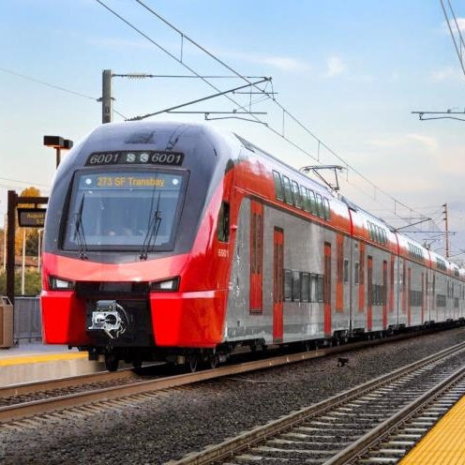
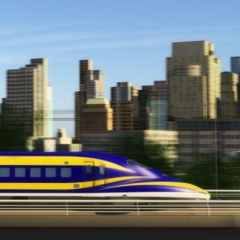
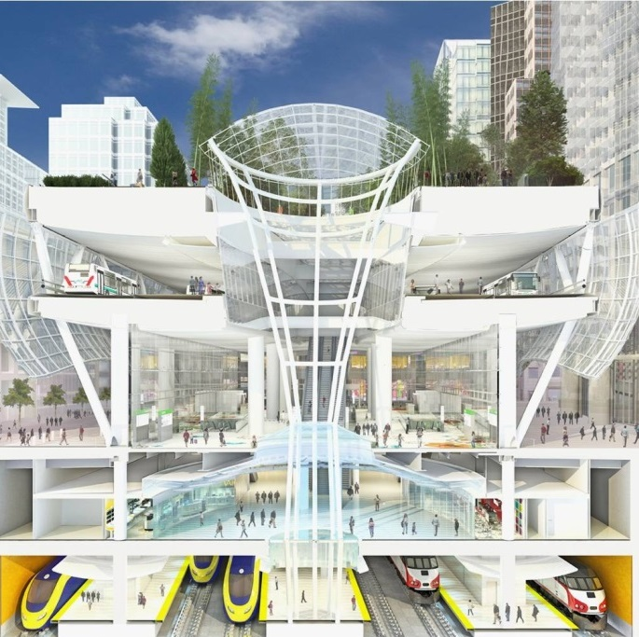
Why now? Major Planned New Infrastructure
Caltrain Electrification
High Speed Rail (HSR)
Salesforce Transit Center
Notes:
The three main keystones for Transportation Infrastructure under construction or planned.
We have the unique opportunity to reshape the future of our region by investing in understanding all possible options for our rail alignment to improve access and quality of life for the entire east side of the City and beyond.

Slide 8
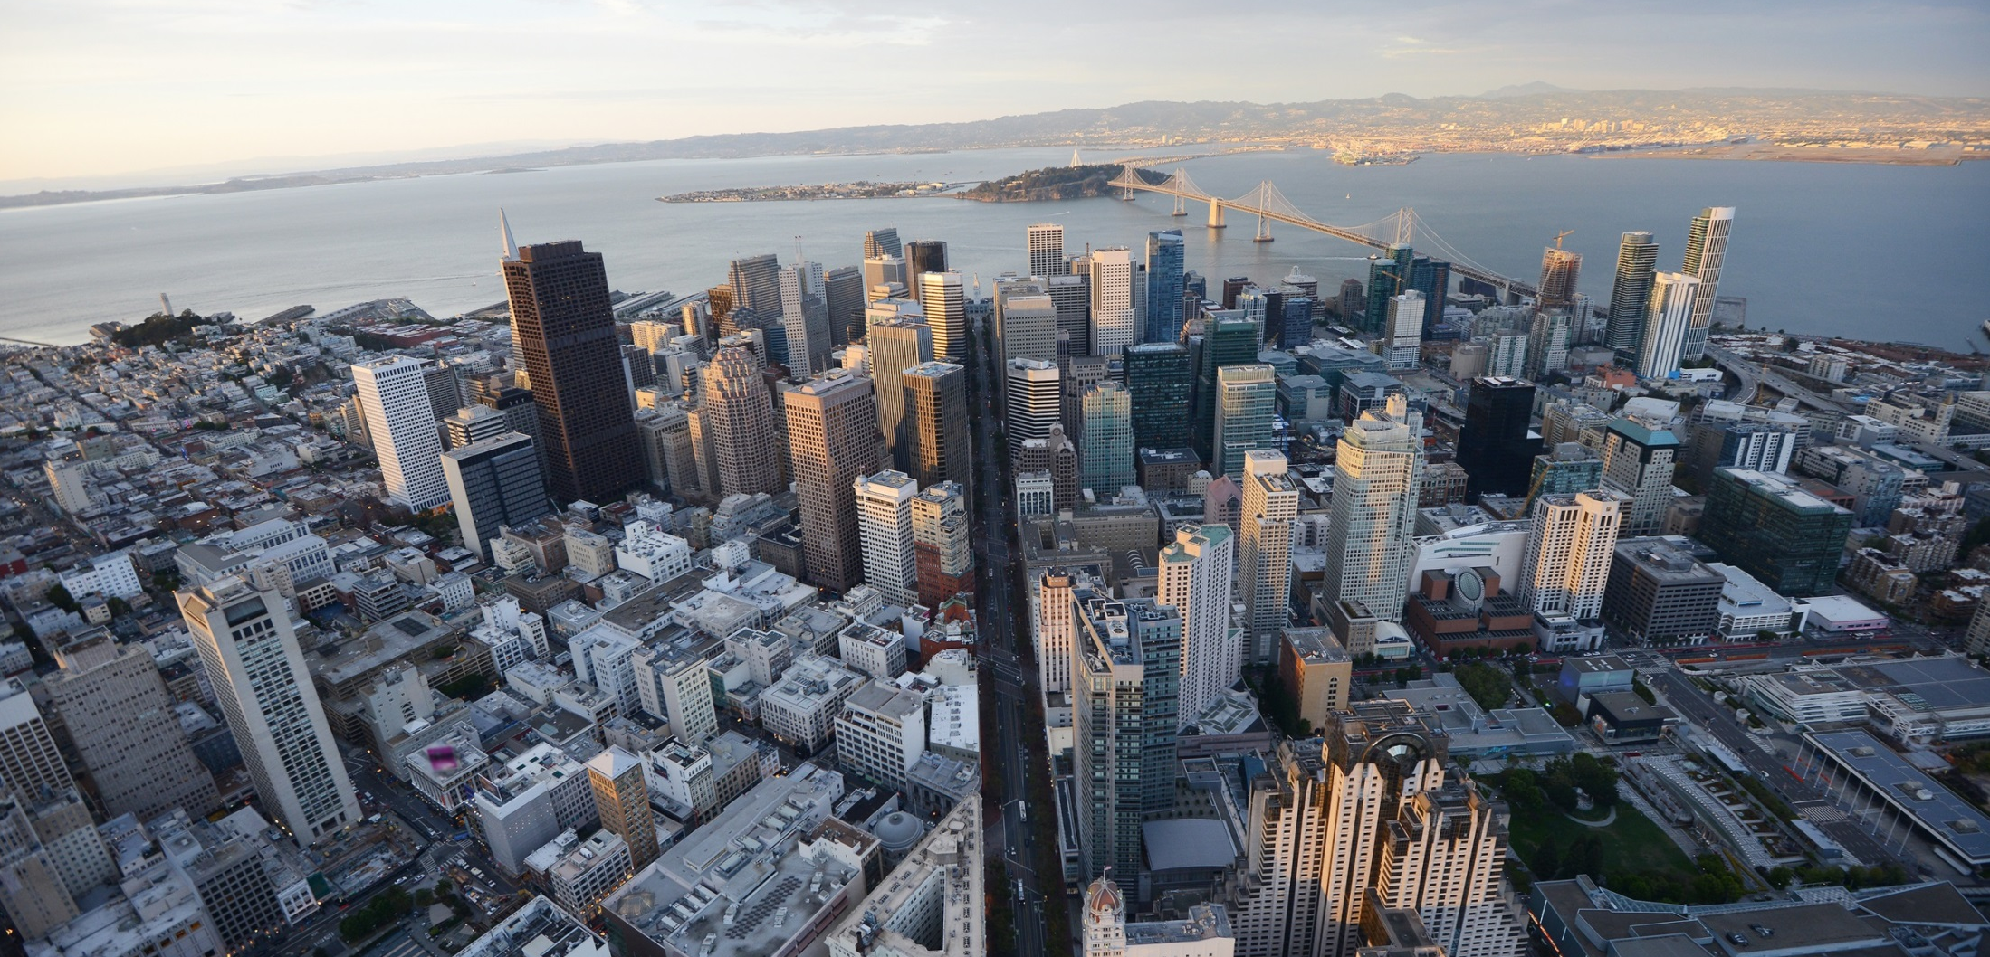
RAB Study Components
Rail Alignment to Salesforce Transit Center (SFTC)
1
Transit Center (SFTC) Loop/Extension
2
Railyard Reconfiguration/ Relocation
3
Boulevard I-280
4
5
Opportunities for the Public’s Benefit
Notes:
So, the RAB started about 4 years ago. Specifically to better understand how other agency projects within San Francisco layered on top of each other and affected how San Francisco grew.
It boils down into 5 components, each with big decisions to be made, each decision independent of the others but to fully grasp what happens with each decision, you need to fully understand the aspects of all 5 components.
Each component represents a major transportation and/or land use decision that needs to be determined in the next 1-15 years that will affect San Francisco for the next 100+ years.
Each component is independent of the others

Slide 9
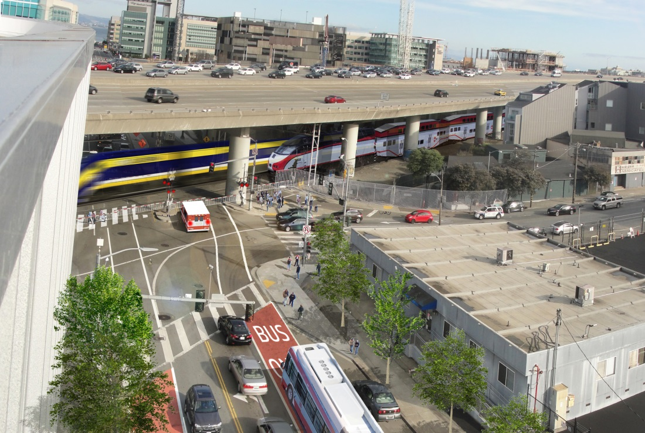
If DTX goes forward:
Closure of surface
streets for 20-30 min
per peak hour
Infrastructure Impacts
IF DTX GOES FORWARD: Closure of surface
streets for 20+ min per peak hour
Infrastructure Impacts

Slide 10
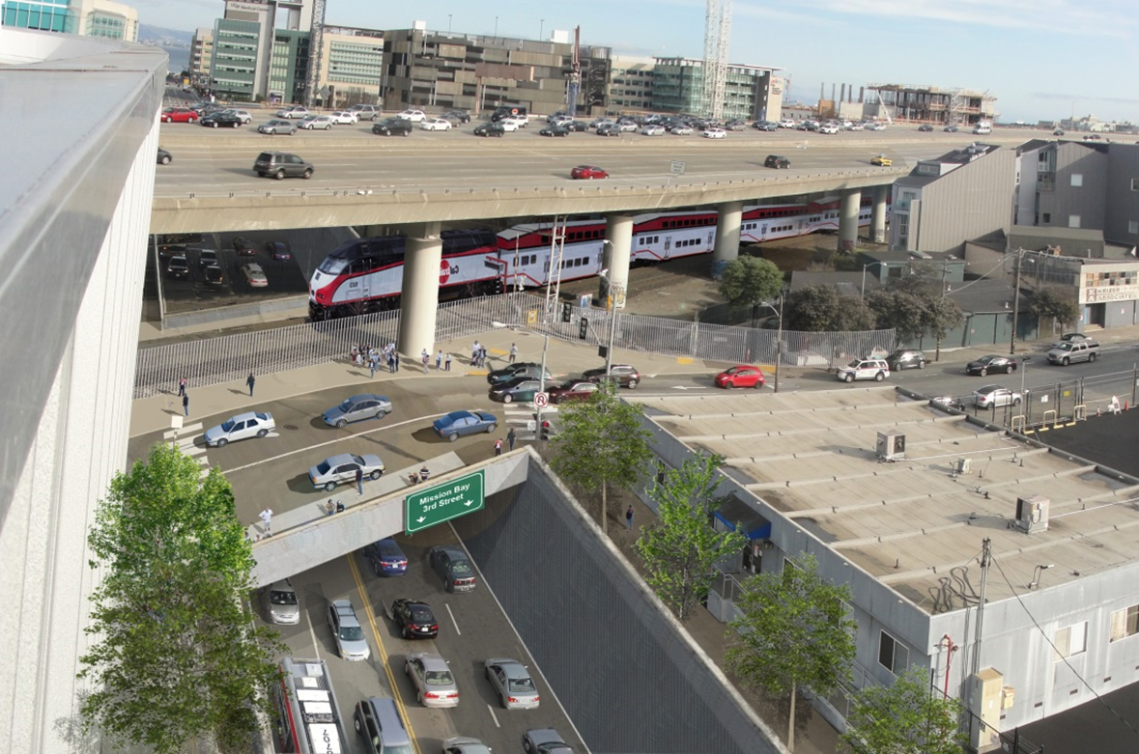
Solution 1:
Move street under train
=further bifurcation
Infrastructure Impacts
SOLUTION 1: Move street under train

Slide 11
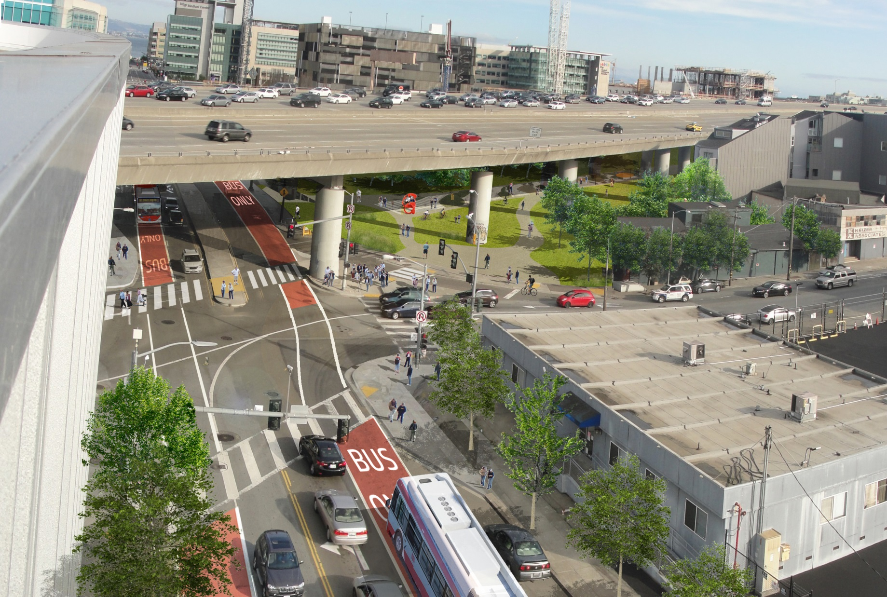
Solution 2:
Move trains underground
= reclaim/reconnect
the surface
Infrastructure Impacts
SOLUTION 2: Move trains underground

Slide 12
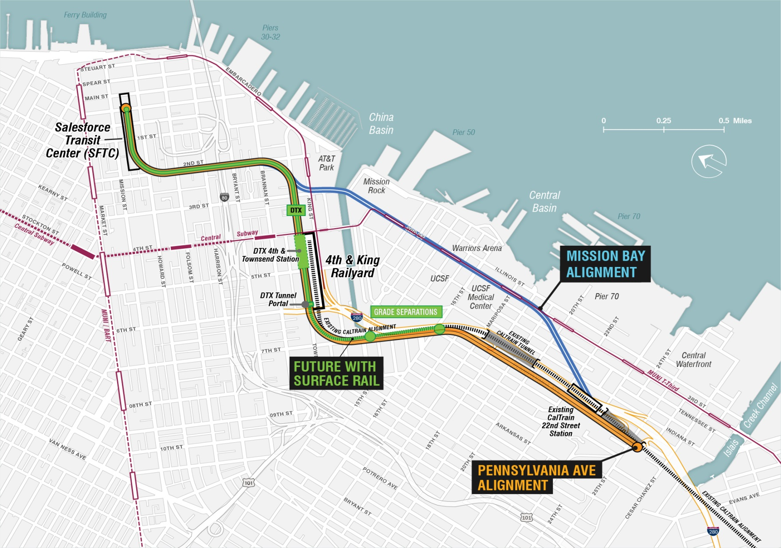
Rail Alignments to Salesforce Transit Center (SFTC)

Slide 13
Rail Alignments to Salesforce Transit Center (SFTC)

Slide 14
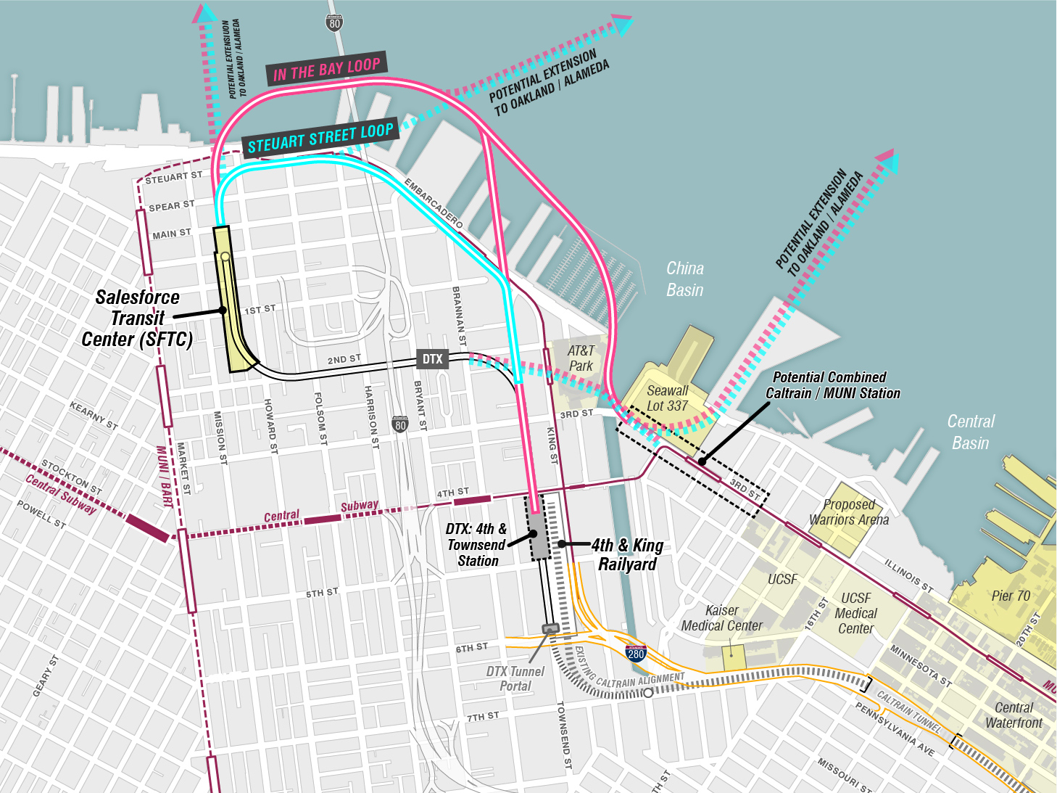
Loops not needed now but will be when more trains travel the corridor
Transit Center (SFTC) Loop/Extension
Loops not needed now but will be when more trains travel the corridor

Slide 15
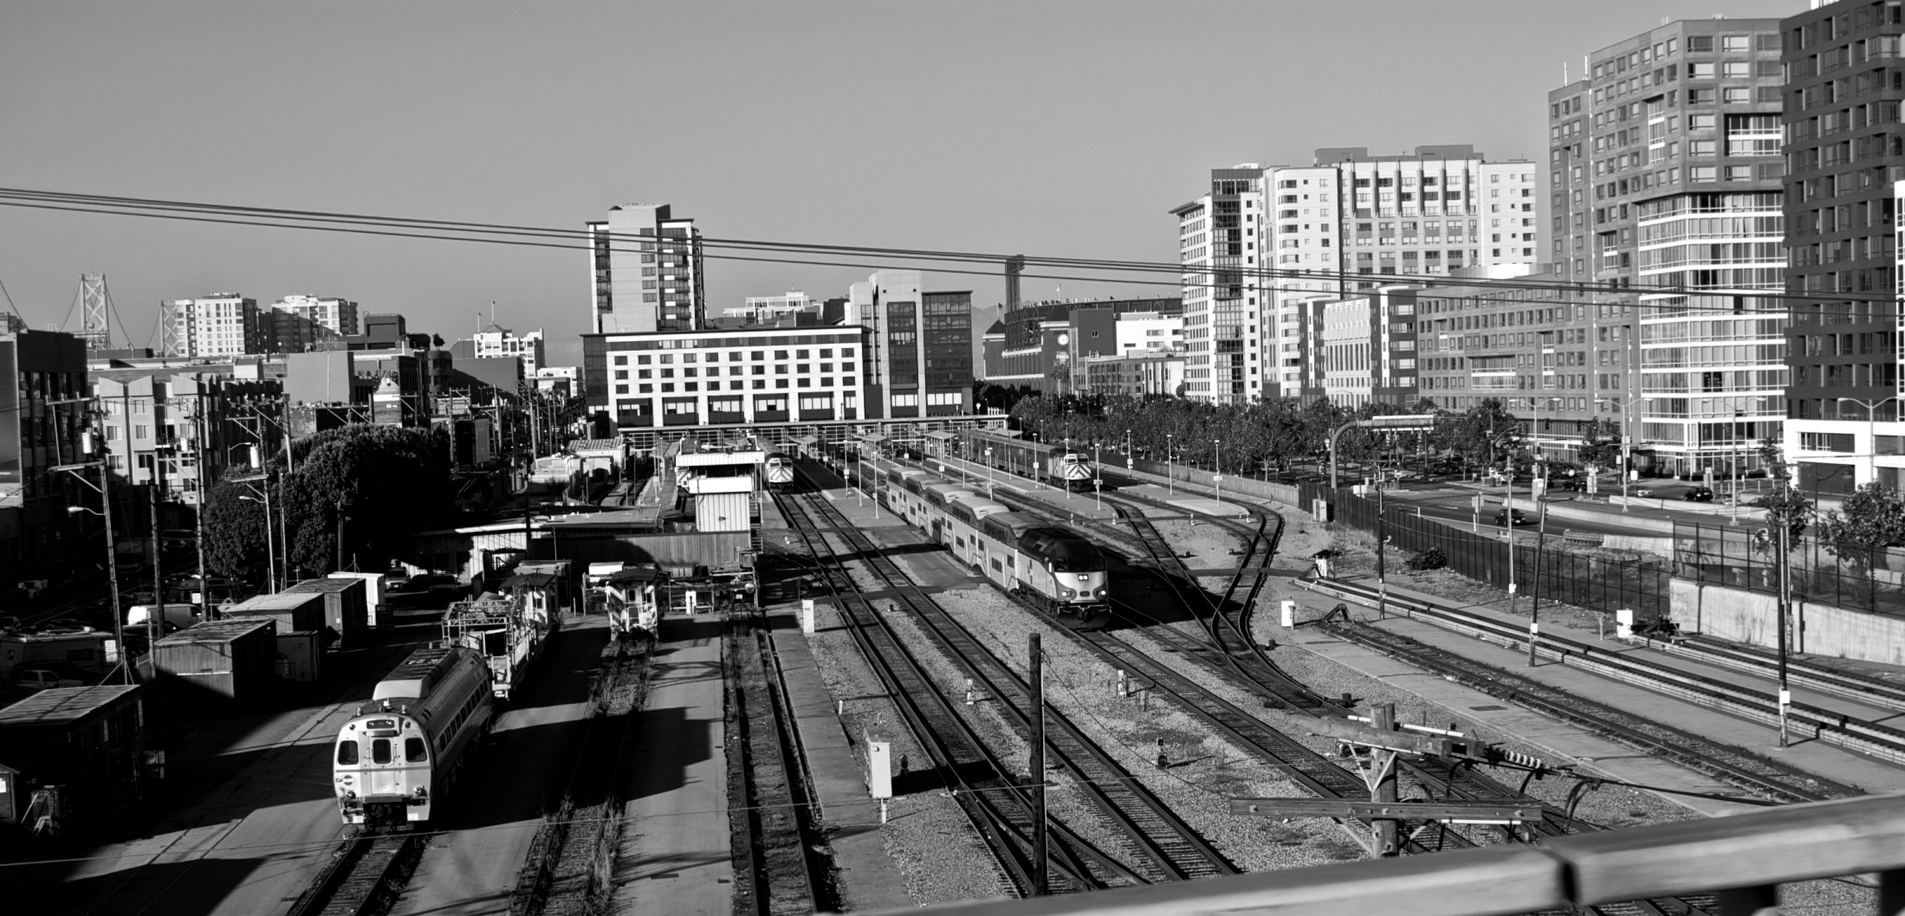
Railyard Reconfiguration/Relocation
What if Caltrain SEPARATED operations from staging and storage/maintenance?

Slide 16
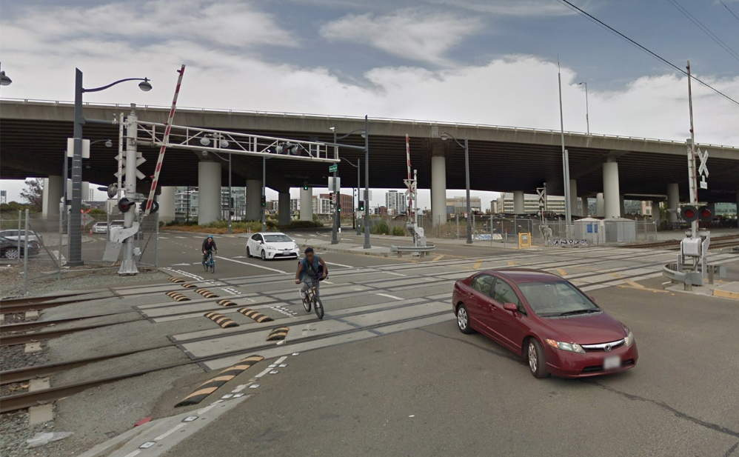
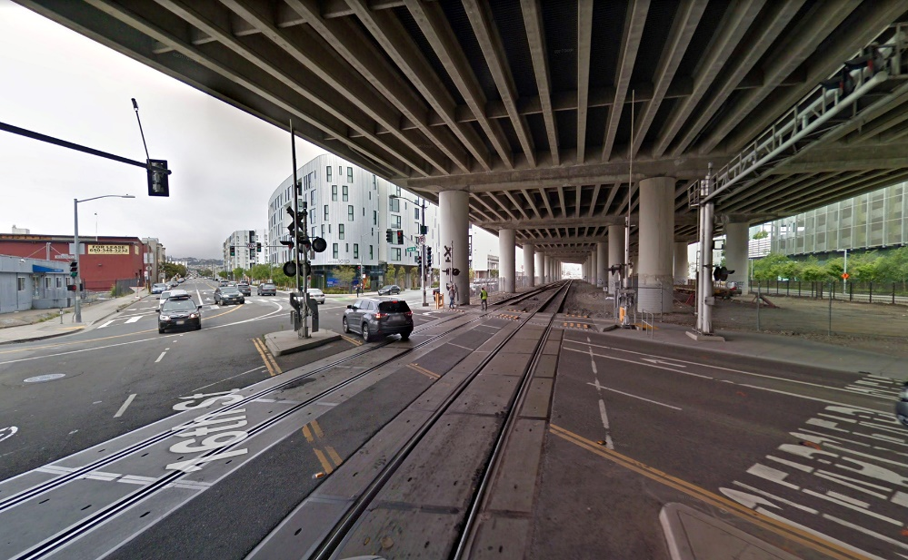
Only two surface street crossings
1
Mission Bay Drive / 7th Street
1
2
1.2 miles
Boulevard I-280: Existing Conditions
2
16th Street

Slide 17
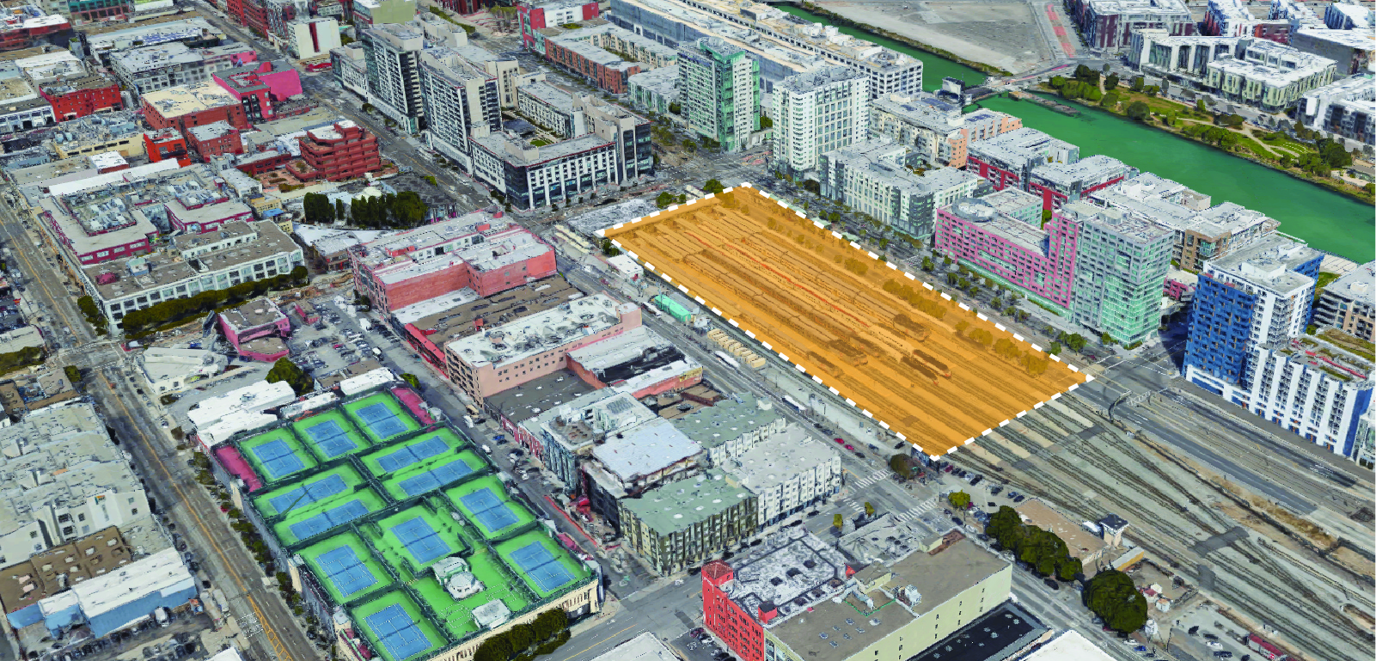
Opportunities for the Public’s Benefit
Restoration of street grid
Improved bike/ped connections
Eliminate rail hazards & noise
Housing
Open Space
Office/Retail

Slide 18
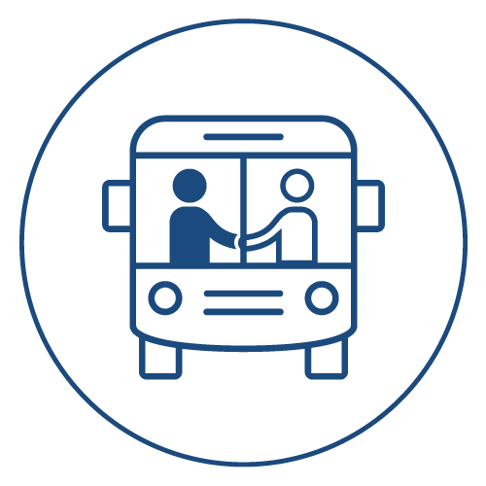
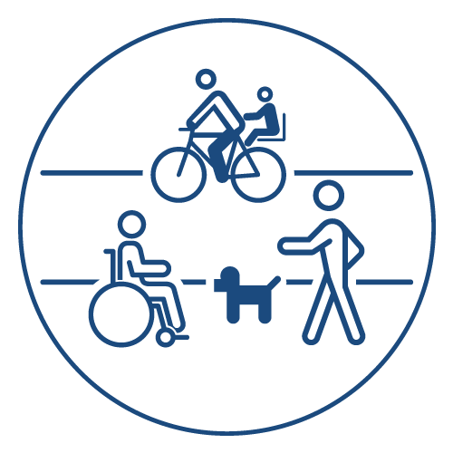
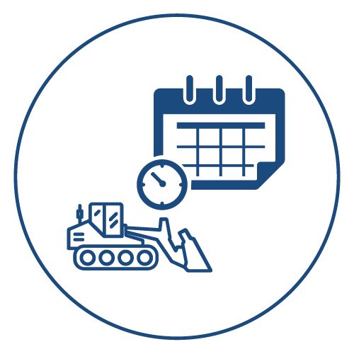
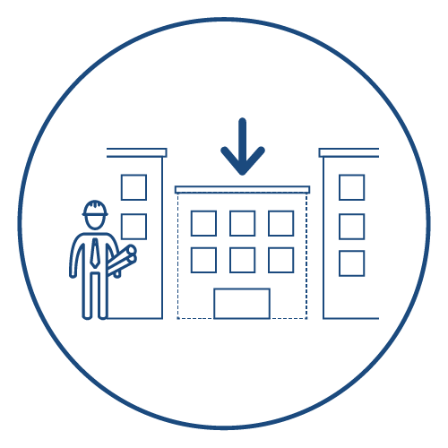
Trade-offs to consider
Connectivity
Operations of all modes
Capacity of all modes
Safety of all modes
Adherence to existing plans/policies
Equity
Construction schedules
Potential development opportunities
Costs
Equity
Operations, capacity,
and safety of all modes
Adherence to existing
plans/policies
Construction schedules
Potential development
opportunities
Costs

Slide 19
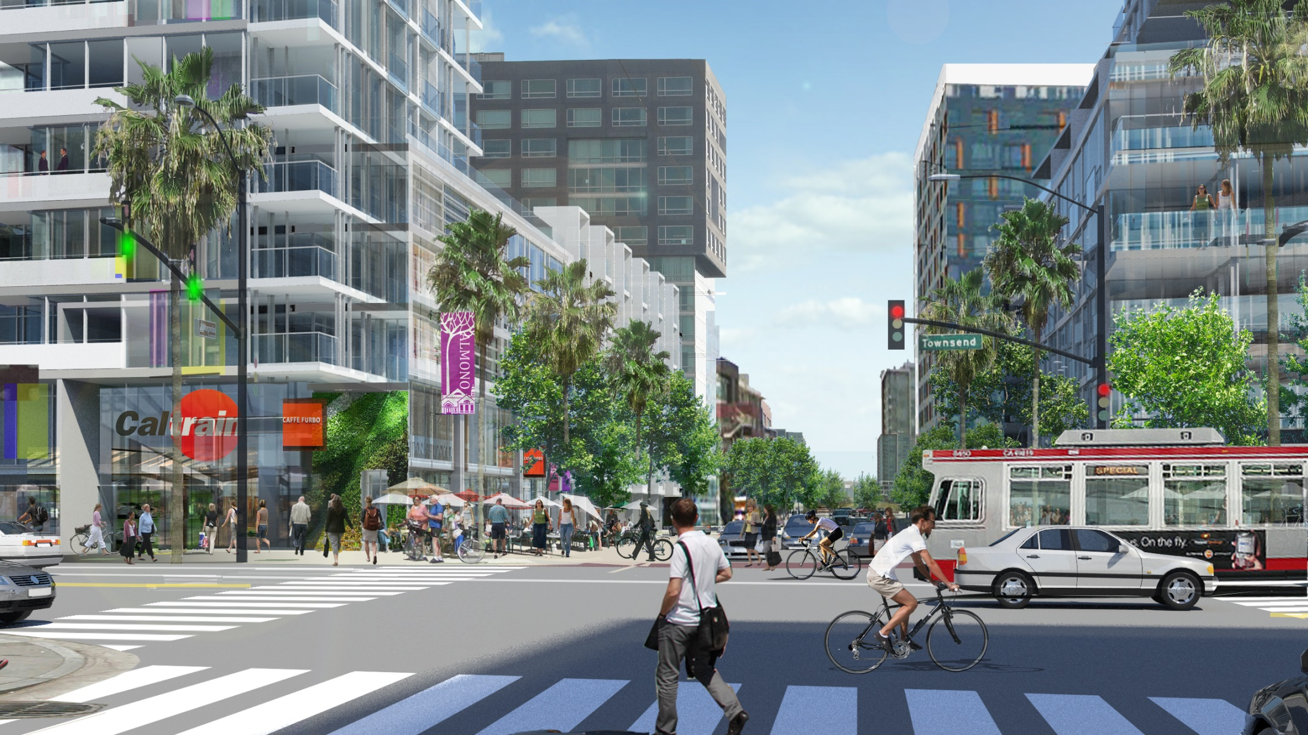
What could the area look like?
5th Street at Townsend looking towards Mission Creek
What it looks like today

Slide 20
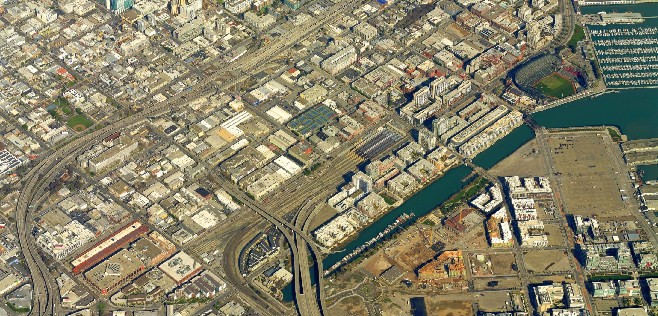
Items to work out & next steps
Political Conversations
Lots of unknowns
Next Steps:
Public Meeting
May 2018
Notes:
So, the RAB started about 4 years ago. Specifically to better understand how other agency projects within San Francisco layered on top of each other and affected how San Francisco grew.
It boils down into 5 components, each with big decisions to be made, each decision independent of the others but to fully grasp what happens with each decision, you need to fully understand the aspects of all 5 components.
Each component represents a major transportation and/or land use decision that needs to be determined in the next 1-15 years that will affect San Francisco for the next 100+ years.
Each component is independent of the others

Slide 21
sf-planning.org/rab
Susan Gygi, PE
Study Manager
Citywide Planning
susan.gygi@sfgov.org
www.sfplanning.org

